Slide 1
Categorical Data
Prof. Andy Field

Slide 2
Aims
Categorical Data
Contingency Tables
Chi-Square test
Likelihood Ratio
Odds Ratio
Loglinear Models
Theory
Assumptions
Interpretation

Slide 3
Categorical Data
Sometimes we have data consisting of the frequency of cases falling into unique categories
Examples:
Number of people voting for different politicians
Numbers of students who pass or fail their degree in different subject areas.
Number of patients or waiting list controls who are ‘free from diagnosis’ (or not) following a treatment.

Slide 4
An Example: Dancing Cats and Dogs
Analyzing two or more categorical variables
The mean of a categorical variable is meaningless
The numeric values you attach to different categories are arbitrary
The mean of those numeric values will depend on how many members each category has.
Therefore, we analyze frequencies.
An example
Can animals be trained to line-dance with different rewards?
Participants: 200 cats
Training
The animal was trained using either food or affection, not both)
Dance
The animal either learnt to line-dance or it did not.
Outcome:
The number of animals (frequency) that could dance or not in each reward condition.
We can tabulate these frequencies in a contingency table.

Slide 5
A Contingency Table

Slide 6
Pearson’s Chi-Square Test
Use to see whether there’s a relationship between two categorical variables
Compares the frequencies you observe in certain categories to the frequencies you might expect to get in those categories by chance.
The equation:
i represents the rows in the contingency table and j represents the columns.
The observed data are the frequencies the contingency table
The ‘Model’ is based on ‘expected frequencies’.
Calculated for each of the cells in the contingency table.
n is the total number of observations (in this case 200).
Test Statistic
Checked against a distribution with (r − 1)(c − 1) degrees of freedom.
If significant then there is a significant association between the categorical variables in the population.
The test distribution is approximate so in small samples use Fisher’s exact test.

Slide 7
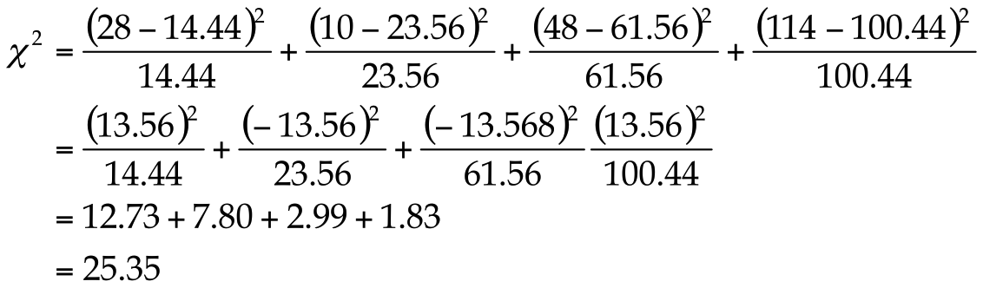
Pearson’s Chi-Square Test

Slide 8
Likelihood Ratio Statistic
An alternative to Pearson’s chi-square
Based on maximum-likelihood theory.
Create a model for which the probability of obtaining the observed set of data is maximized
This model is compared to the probability of obtaining those data under the null hypothesis
The resulting statistic compares observed frequencies with those predicted by the model:
i and j are the rows and columns of the contingency table and ln is the natural logarithm
Test Statistic
Has a chi-square distribution with (r − 1)(c − 1) degrees of freedom.
Preferred to the Pearson’s chi-square when samples are small.

Slide 9
Likelihood Ratio Statistic

Slide 10
Interpreting Chi-Square
The test statistic gives an ‘overall’ result.
We can break this result down using standardized residuals
There are two important things about these standardized residuals:
Standardized residuals have a direct relationship with the test statistic (they are a standardized version of the difference between observed and expected frequencies).
These standardized are z-scores (e.g. if the value lies outside of ±1.96 then it is significant at p < .05 etc.).
Effect Size
The odds ratio can be used as an effect size measure.

Slide 11
Loglinear Analysis
When?
To look for associations between three or more categorical variables
Example: Dancing Dogs
Same example as before but with data from 70 dogs.
Animal
Dog or cat
Training
Food as reward or affection as reward
Dance
Did they dance or not?
Outcome:
Frequency of animals

Slide 12
Theory
Our model has three predictors and their associated interactions:
Animal, Training, Dance, Animal × Training, Animal × Dance, Dance × Training, Animal × Training × Dance
Such a linear model can be expressed as:
A loglinear Model can also be expressed like this, but the outcome is a log value:

Slide 13
Backward Elimination
Begins by including all terms:
Animal, Training, Dance, Animal × Training, Animal × Dance, Dance × Training, Animal × Training × Dance
Remove a term and compares the new model with the one in which the term was present.
Starts with the highest-order interaction
Uses the likelihood ratio to ‘compare’ models:
If the new model is no worse than the old, then the term is removed and the next highest-order interactions are examined, and so on.

Slide 14
Important Points
The chi-square test has two important assumptions:
Independence:
Each person, item or entity contributes to only one cell of the contingency table.
The expected frequencies should be greater than 5.
In larger contingency tables up to 20% of expected frequencies can be below 5, but there a loss of statistical power.
Even in larger contingency tables no expected frequencies should be below 1.
If you find yourself in this situation consider using Fisher’s exact test.
Proportionately small differences in cell frequencies can result in statistically significant associations between variables if the sample is large enough
Look at row and column percentages to interpret effects.

Slide 15
General Procedure for analysing categorical outcomes

Slide 16
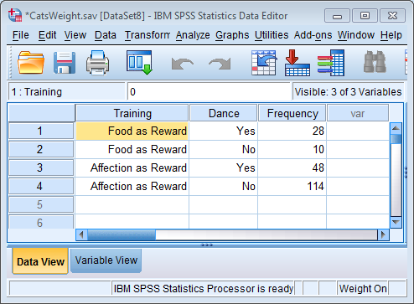
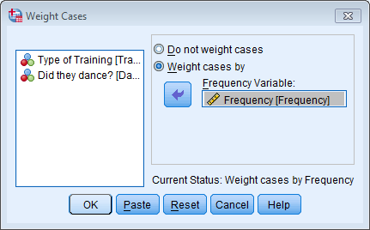
Chi-Square in SPSS: Weighting Cases

Slide 18
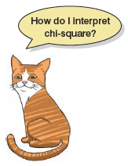
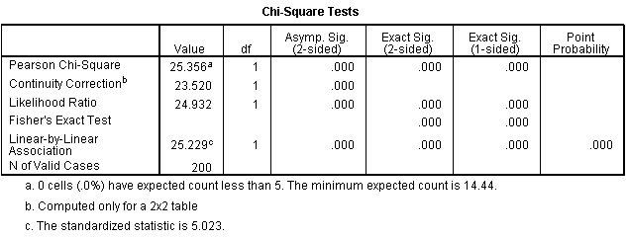
Output

Slide 19
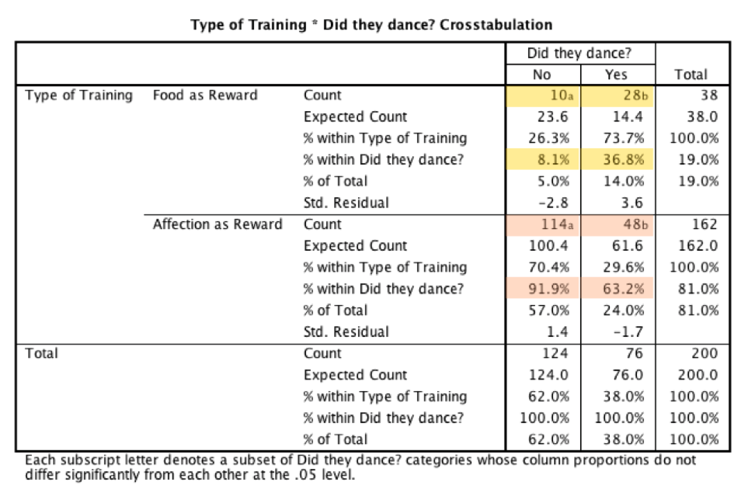
Output

Slide 20
The Odds Ratio

Slide 21
Interpretation
There was a significant association between the type of training and whether or not cats would dance χ²(1) = 25.36, p < .001. Based on the odds ratio, the odds of cats dancing were 6.65 times higher if they were trained with food than if trained with affection.

Slide 22
Loglinear Models in SPSS

Slide 23
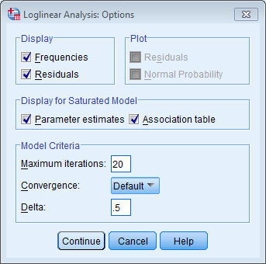
Loglinear Models: Options

Slide 24
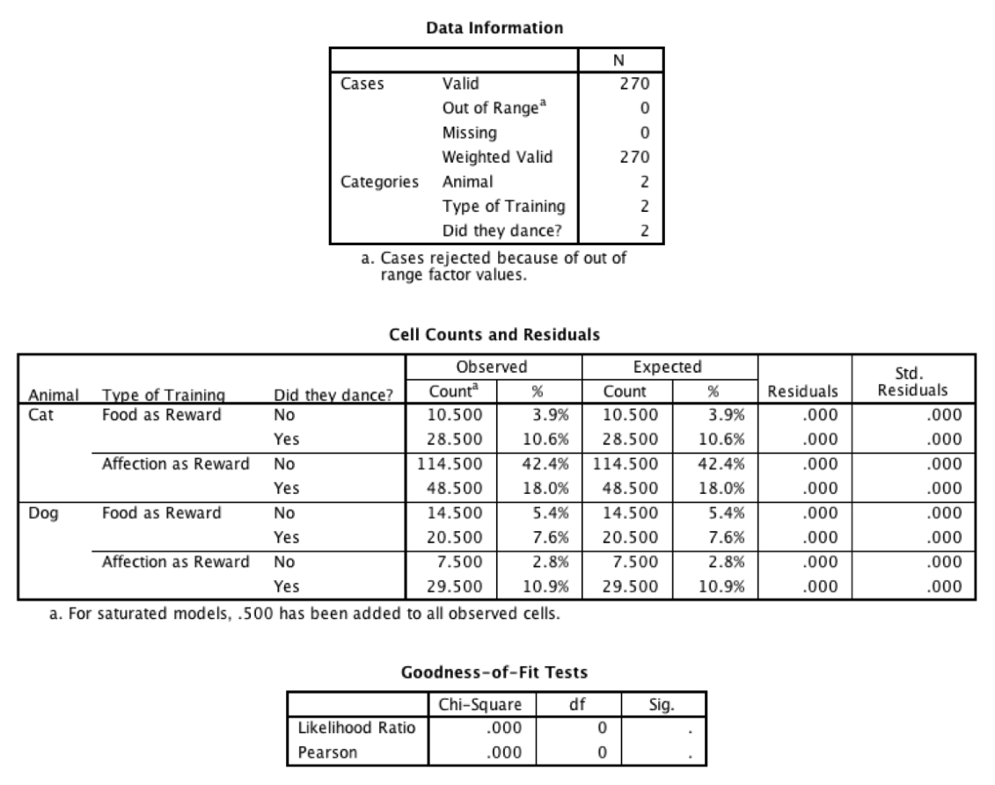
Output from a Loglinear Model

Slide 25
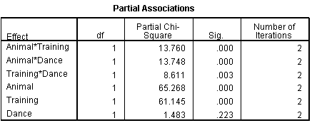
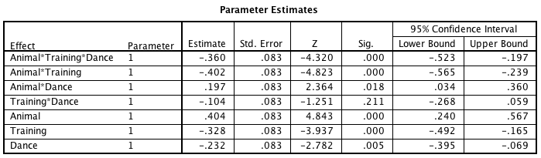
Output from a Loglinear Model

Slide 26
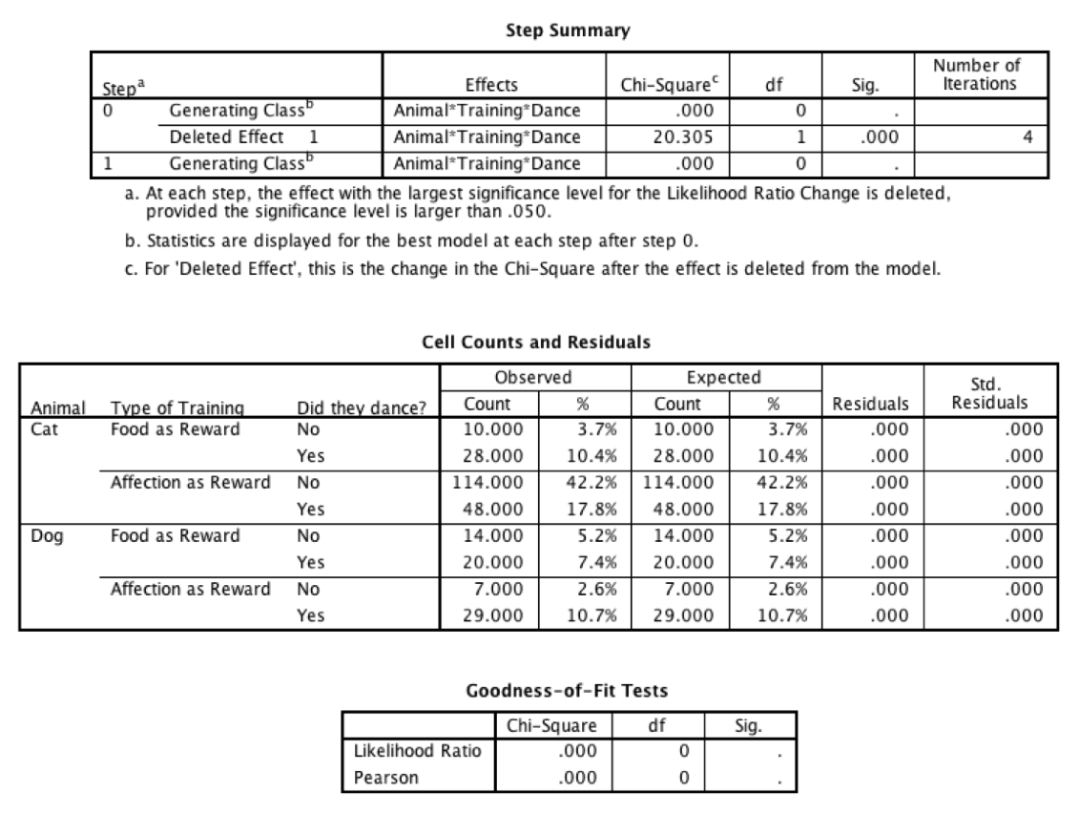
Output from a Loglinear Model

Slide 27
Visual Interpretation

Slide 28
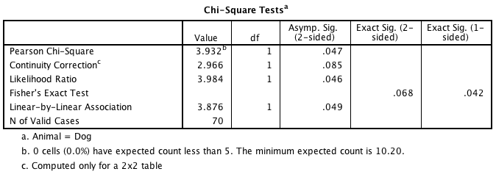
Following up with Chi-Square Tests
Cats:
Dogs:

Slide 29
The Odds Ratio for Dogs

Slide 30
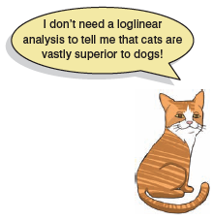
Interpretation
Loglinear analysis produced a final model that retained all effects. The animal × training × dance interaction was significant, χ²(1) = 20.31, p < .001.
Chi-square tests on the training and dance variables were performed separately for dogs and cats.
For cats, there was a significant association between the type of training and whether or not cats would dance, χ² (1) = 25.36, p < .001; this was true in dogs also, χ² (1) = 3.93, p = .047.
The odds of dancing were 6.65 higher after food than affection in cats, but only 0.35 in dogs (i.e. in dogs, the odds of dancing were 2.90 times lower if trained with food compared to affection).
The analysis reveals that cats are more likely to dance for food rather than affection, whereas the opposite is true for dogs.

Slide 31
To Sum Up …
We approach categorical data in much the same way as any other kind of data:
we fit a model, we calculate the deviation between our model and the observed data, and we use that to evaluate the model we’ve fitted.
We fit a linear model.
Two categorical variables
Pearson’s chi-square test
Likelihood ratio test
Three or more categorical variables:
Loglinear model.
For every variable we get a main effect
We also get interactions between all combinations of variables.
Loglinear analysis evaluates these effects hierarchically.
Effect Sizes
The odds ratio is a useful measure of the size of effect for categorical data.

